Slide 1

Software Engineering
Pre-work: Day 5

Slide 2

Learning Objectives
Connecting an external javascript file
Learn conditionals
Create functions
Manipulating HTML Elements

Slide 3

External Javascript File
So far we learned about keeping our CSS in an external stylesheet in order to keep the styling separate from your HTML. We can do the same thing with Javascript.
A Javascript file will always have the extension .js at the end of its name.
The syntax remains the same and the only thing that goes into the script tag in your HTML is the link to your external Javascript file.

Slide 4
Linking stylesheet to HTML file
Linking a javascript file to an html file is very straightforward. Assuming the javascript file is named index.js and is in the same folder:
You will need to add the usual script tag to your html file inside of the body tags under the other html elements.
Inside of the opening script tag, insert the attribute src and have it equal to “index.js”.
Example: <script src=”index.js”></script>

Slide 5
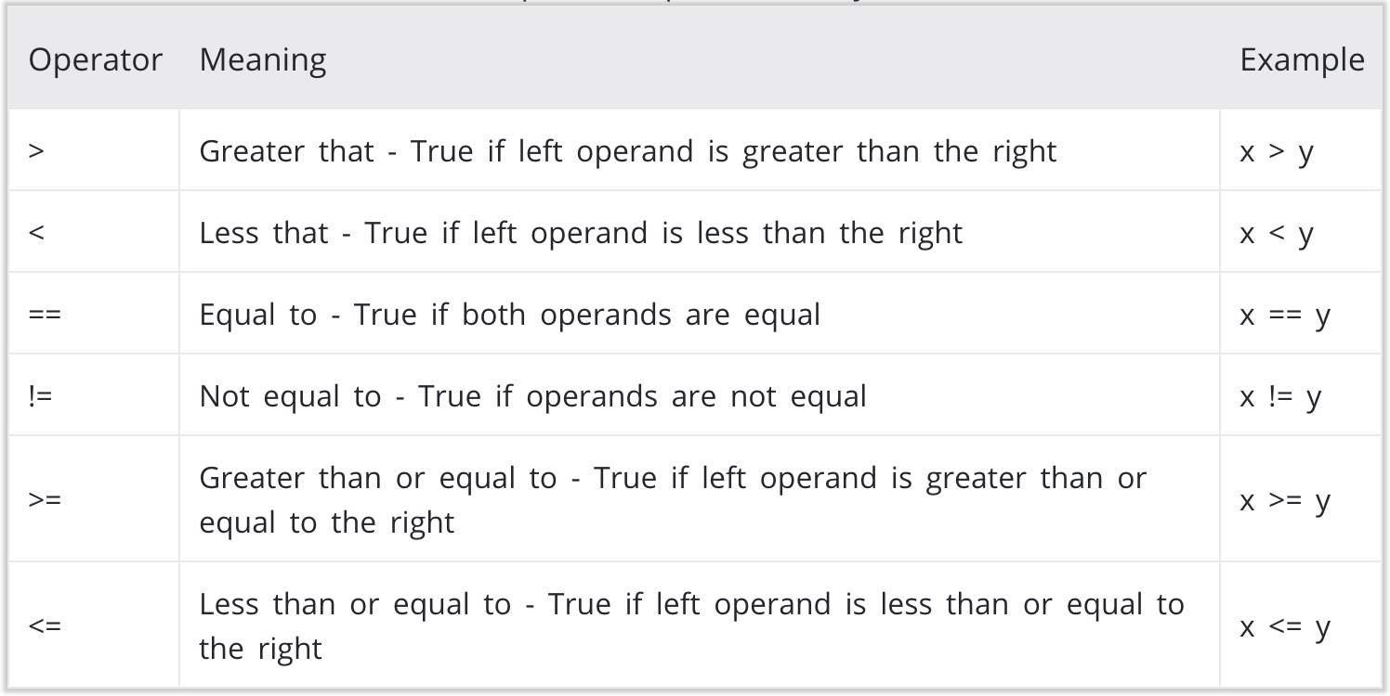
Comparison Operators
Comparison operators check two values and return a boolean (true or false)

Slide 6
Conditionals if/else
Example
let condition = 10;
If (condition == 10) {
console.log(“This is true”);
} else {
console.log(“This is false”);
}
This will console log “This is true”
When we program, we sometimes want to perform a certain task only if a certain condition is met. If the condition is not met, we want to perform a different task. We can do this by using an if and else statement.

Slide 7
Conditionals else if
Example
let condition = 10;
If (condition == 5) {
console.log(“Condition is 5”);
} else if (condition == 10) {
console.log(“Condition is 10”);
} else {
console.log(“This is false”);
}
This will console log “Condition is 10”
Sometimes we might need to check for multiple conditions. For this we can use an else if statement in order to add more conditions.

Slide 8
Functions
Functions are blocks of organized, reusable code, that is used to perform a single, related action.
As you already know, Javascript gives you many built-in functions like console.log(), etc. but you can also create your own functions. These functions are called user-defined functions.

Slide 9
Defining a Function
You can define functions to provide the required functionality. Here are simple rules to define a function in Javascript.
Function blocks begin with the keyword let or const followed by the function name, an equals sign = , parentheses ( ), an arrow => and curly braces { }
Any input parameters or arguments should be placed within these parentheses. You can also define parameters inside these parentheses.
The statement return exits a function and can return a value.
Example
const greeting = ( ) => {
return “Hello”
}
This function returns the string “Hello”

Slide 10
Calling a Function
Example
const greeting = (string) => {
return string
}
greeting(“Hello”)
This function takes in a string as a parameter and returns it. When we call the function we provide it with our string and so it returns “Hello”.
Defining a function gives it a name, specifies the parameters that are to be included in the function and structures the blocks of code.
Once the basic structure of a function is finalized, you can execute it by calling its name with parenthesis.
If the function takes in a parameter, you will have to insert it into the parentheses when calling the function.

Slide 11
Calling a Function inside a function
You can call functions inside of functions. For example if you want to actually console log what your function returns, you will need to call the function inside of your console log.
Example
const greeting = (string) => {
return string
}
console.log(greeting(“Hello”))

Slide 12
Break statement
There is another way to break out of any loop and that’s with the break statement. This automatically breaks you out of a loop regardless of whether or not a condition is true.
Example
let i = 0;
while (i < 5) {
console.log(“Looping”);
I++;
break;
}
>>>> Logs “Looping” 1 time due to the break statement
Example
for (let i = 0; i < 5; i++) {
console.log(“Looping”);
break;
}
>>>> Logs “Looping” 1 time due to the break statement

Slide 13

Manipulating the HTML DOM
DOM Tree
Whenever a web page loads, the browser creates a DOM or a Document Object Model of the page.
As web developers, we can interact with this object and we can make changes to the DOM, the browser will then redraw the web page to reflect the changes we made to the DOM.
We can also draw our HTML as a tree, with the document as the parent, and then have relations of parent and children relationships and sibling relationships.

Slide 14
querySelector( )
The querySelector( ) method returns the first HTML element that matches one or more CSS selector (class name, id name, or element tag).
You will need to specify what you’re querying inside of the parentheses, wrapped in quotes.
All pages start with the root of document so we will need to access document before using querySelector.
You can then save this element to a variable in order to manipulate it later.
Example
Query by class
const titleEl = document.querySelector(‘.title’)
Query by id
const nameEl = document.querySelector(‘#name’)
Query by tag
const firstDivEl = document.querySelector(‘div’)

Slide 15
Style with Javascript
Once you have an element saved to a variable there are multiple ways to manipulate it. You can call other functions and even dynamically change the style without using your CSS file.
style allows you to add CSS styling. Once you type .style on the element you’re manipulating, you will then follow up with the CSS property that you want to use.
In the example we used .style.color followed by the value we want to give it. Make sure it is a valid value and is wrapped in quotes.
Example
const nameEl = document.querySelector(‘#name’);
nameEl.style.color = ‘green’;
This turns the text for the element in nameEl green.

Slide 16
addEventListener( )
Events refer to what happens to an HTML element, such as clicking, focusing, etc to which we can react with JavaScript. We can assign functions to listen for these events in elements and do something when the event has occurred.
Once you query an HTML element and save it to a variable, you can then use addEventListener( ) to manipulate your element based on the event it is listening for.
This function takes in two parameters separated by commas, an event and a function with the code you want to use.
addEventListener(event, function)
Example
const nameEl = document.querySelector(‘#name’)
const turnRed = (element) => {
nameEl.style.color = ‘red’;
}
nameEl.addEventListener(‘click’, turnRed)
This will turn the text red whenever we click on the element. Notice that we are not adding parentheses to turnRed in the eventListener. This ensure that it will ONLY get called when clicked.

Slide 17


